Slide 1
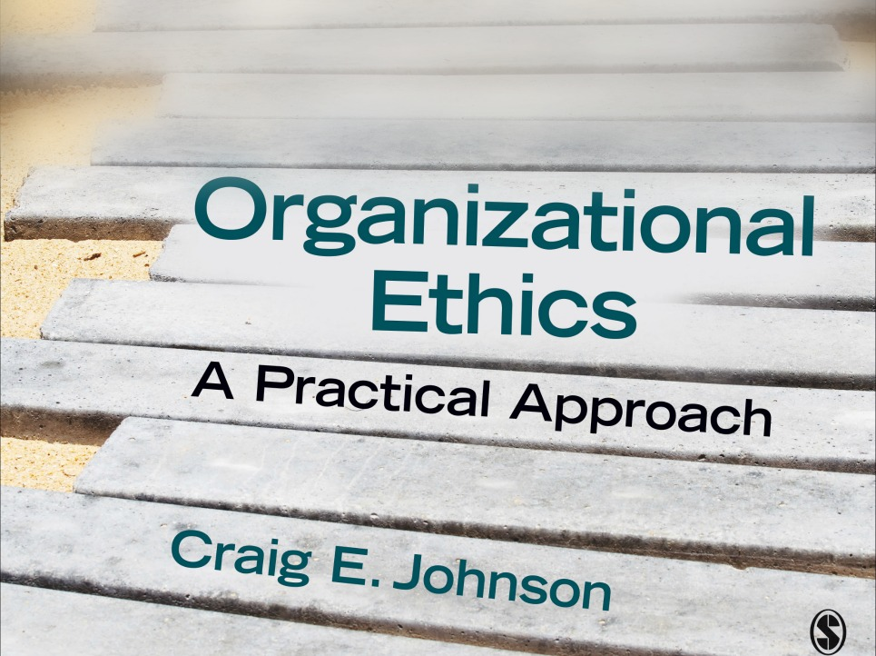
Chapter 5: Exercising
Ethical Influence

Slide 2
Introduction
We spend considerable time influencing others in organizational settings.
Exercising influence is NOT an option.
Must influence others to carry out our roles
Our influence choices will help determine the ethical health of our organizations

Slide 3
Questions of Power
Power = the capacity to control the behavior of others
The greater the power, the more likely that others will comply
To wield power ethically, must answer these questions:
  Are some forms of power more ethical than others?
  Is it possible to have too much power?
  Should I play politics?
  What factors contribute to empowerment?
  How do I overcome barriers to empowerment?

Slide 4
Question 1: Are Some Forms of
Power More Ethical Than Others?
Sources of Power:
  Coercive power: based on penalties or punishments
  Reward power: deliver something of value to others (tangible or intangible)
  Legitimate power: resides in the position
  Expert power: knowledge, skills, education
  Referent (role model) power: rests on admiration of another person

Slide 5
Are Some Forms of Power
More Ethical Than Others?
No form of power is inherently immoral
Must draw upon a variety of power sources to be effective
Should employ power towards worthy objectives
Hard power linked to organizational position (coercive, reward, legitimate) is more dangerous than soft power linked to the person (expert, referent)
Coercive power is most dangerous and should only be used as a last resort.

Slide 6
Question 2: Is it Possible to
Have Too Much Power?
Concentration of power produces unethical behavior.
  “Power corrupts and absolute power corrupts absolutely.” Lord Acton
Positional power is most susceptible to abuse
Why unfettered power is abused:
  Powerful individuals project their inner darkness
  Powerful individuals are more susceptible to judgment biases
  The powerful attack those they perceive as threats
  Powerful individuals rely more heavily on positional power
  To reduce the dangers of concentrated power:
  Be open to influence
  Enact formal mechanisms to limit the exercise of power

Slide 7
Is it Possible to Have Too Much Power?
Powerlessness also poses ethical dilemmas
The powerless focus on maintaining limited power
Powerless individuals take out their frustrations on others and the organization
Powerlessness impairs cognitive functioning
How to cope with a low power position
  Highlight your interdependence with the powerful person
  Be persistent
  Stay actively engaged with the person in power

Slide 8
Question 3: Should I play Politics?
Definition: use of informal (non sanctioned) power to achieve personal and/or organizational objectives
Informal power is a fact of organizational life
While informal power is often misused we need to use informal power to achieve worthy objectives

Slide 9
Should I Play Politics?
Abandon negative politics and practice positive politics
Negative politics: self-centered, controlling, manipulative; win at all costs; violates ethical standards; focus on efficiency
Positive politics: supports the group; power used to serve; focus on shared vision and values; collaborative; considers ethical implications and following moral standards

Slide 10
Question 4: What Factors
Contribute to Empowerment?
Giving power away supports ethical values and boosts the bottom line
Empowerment can increase your power
Psychological empowerment—the increased motivation to carry out tasks associated with work roles
  Factor 1: meaning (values placed on the task)
  Factor 2: competence (belief that can do the job required)
  Factor 3: self-determination (choice over how to carry out the task
  Factor 4: Impact (extent of influence over the larger organizational environment)

Slide 11
Question 5: How do I Overcome
Barriers to Empowerment?
Empowerment barriers
  Keeping authority is often rewarded
  Risk of a new approach
  Managers lose control
  Requires a new skill set
  Follower anxiety about a new system
Stages of Empowerment
  Stage 1: Starting and orienting the process of change
  Stage 2: Making changes and dealing with discouragement
  Stage 3: Adopting and refining empowerment to fit the organization

Slide 12
Ethical Issues in Influence
Importance of choosing the right influence tactic
Ethical considerations should play a central role
Overview of Organizational Influence Strategies
  Proactive tactics
  Impression management
  Deception
  Emotional labor
  Communication of expectations

Slide 13
Proactive Tactics
Definition: focused on achieving immediate objectives by convincing targets to go along with requests
Types
    Rational Persuasion
    Apprising
    Inspirational appeals
    Consultation
    Collaboration
    Ingratiation
    Personal appeals
    Exchange
    Coalition tactics
    Legitimating tactics
    Pressure
Legitimating and pressure tactics are more likely to be abused.
Rational persuasion, consultation, collaboration, inspirational appeal pose less danger

Slide 14
Impression Management
Definition: how people try to control the images others have of them through their behaviors
Organizations act as stages
Impression management categories
  Acquisitive: attempts to be seen in a positive light
  Protective: attempts to avoid looking bad
  Direct (straightforward efforts to create a desirable image)
  Indirect (shape image through association with positive events and people)

Slide 15
Impression Management
Ethical issues
  Less qualified people get ahead
  Manipulation
  Deceit
Beneficial impression management
  Serves the organization
  Accurate
  Consider impact on co-workers
  Targets base decisions on objective criteria

Slide 16
Deception
Definition: knowingly trying to mislead others
Liars: (a) aware that the information is false, (b) knowingly deliver a message, with (c) the intent to mislead someone else.
Causes of lying: sel-finterest and role conflict
Almost universally condemned but exceptions exist
Principle of veracity: the burden of proof is upon those who lie
Reduce the frequency of deception
  Reduce role conflicts
  Reward integrity
  Make honesty a key organizational value

Slide 17
Emotional Labor
Definition: a form of impression management done for pay with outsiders
Frequently used by frontline service workers
Can express negative as well as positive emotions
Ethical Issues
  Emotions are now “owned” by the organization
  Conflict between authentic selves and rules
  Dissonance of expressing to display emotions that aren’t felt
  Intrusive “scripts”
Surface acting: disconnect between feelings and emotional expressions which is stressful
Deep acting: workers embrace their roles which reduces stress
Reduce the damage done by emotional labor by matching employees with positions (which reduces surface acting),, allowing for the freedom of emotional expression and providing support
As outsiders, respond tactfully but honestly to emotional displays

Slide 18
Communication of Expectations
We live up to expectations others place on us (the Pygmalion Effect)
The Pygmalion Effect has the strongest impact on disadvantaged groups, those unsure of their abilities and men
Golem effect: negative expectations that lower performance
Channels for communicating expectations
  Verbal persuasion
  Climate—social and emotional atmosphere
  Input—number and type of assignments
  Output—more opportunities to speak up
  Feedback—receiving more feedback from supervisors

Slide 19
Communication of Expectations
Ethical Issues
  Deception (communicating misleading expectations)
  Separation by ability (communicating high expectations to only some employees)
Ethical alternatives
  Communicate high expectations to everyone in the organization
  Communicate high expectations in interactions with peers and followers
  Insulate yourself from the negative expectations of leader through the Galatea effect (have high self-expectations)

